Slide 1
HTML TAGS
MCNDHS
Ms. Eng

Slide 2
AIM: HOW DO WE CREATE TABLES IN HTML?
Do now:
TO GET CREDIT:
INCLASS ASSIGNMENT
Daily Grade:
On-time/attendance/not leaving the classroom: 25%
Cellphones: 25%
Notes:25%
Classwork/Homework: 25%

Slide 3
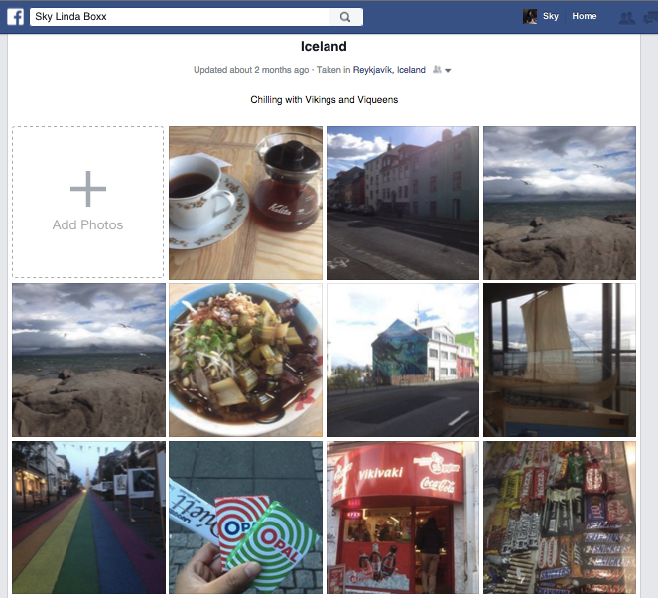
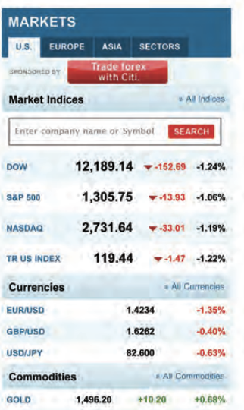
WHERE YOU SEE IT

Slide 4

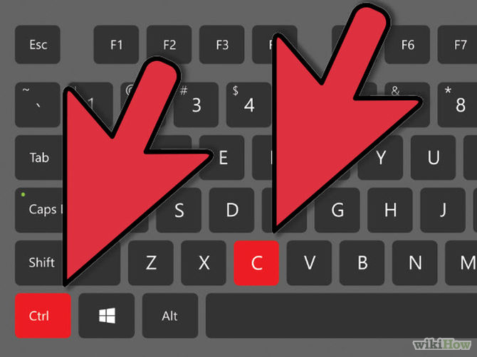
KEYBOARD SHORTCUTS
Shortcuts on a keyboard makes working faster!

Slide 5
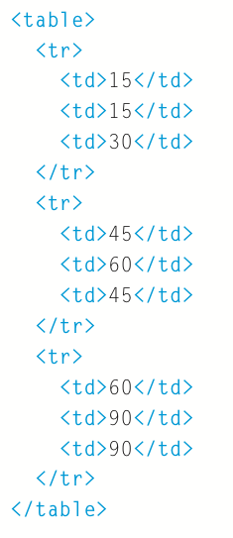
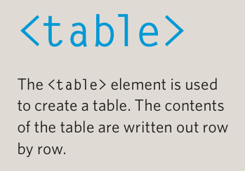

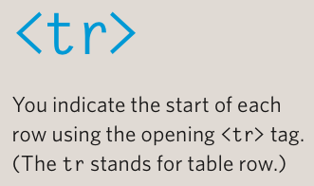
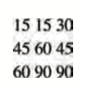

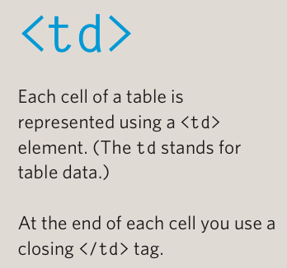

COMPONENTS OF A TABLE

Slide 6
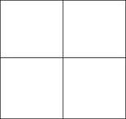
WITH IMAGES:
<table>
<tr>
<td>
<img src=“ “ alt=“ “ height=“ “ width=“ “>
</td>
<td>
<img src=“ “ alt=“ “ height=“ “ width=“ “>
</td>
</tr>
<tr>
<td>
<img src=“ “ alt=“ “ height=“ “ width=“ “>
</td>
<td>
<img src=“ “ alt=“ “ height=“ “ width=“ “>
</td>
</tr>
</table>

Slide 7
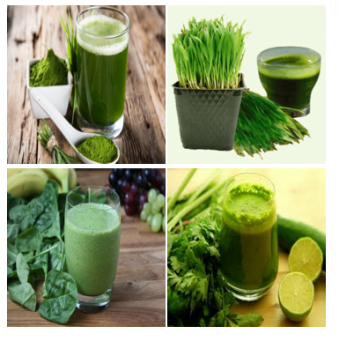
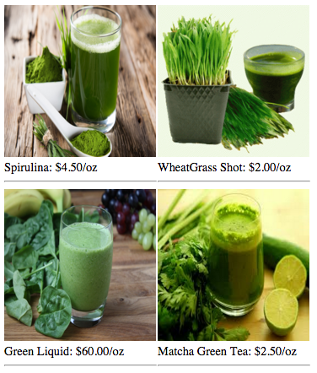
ACTIVITY
Create this: Challenge:

